Slide 1


Slide 2
What is node.js?
Server-side Javascript Built on Google’s V8 Evented, non-blocking I/O. EventMachine or Twisted.
CommonJS module system.
8000 lines of C/C++, 2000 lines of Javascript, 14 contributors.
●
●
●
●
●
●

Slide 3
Main Goal
To provide a purely evented, non-blocking infrastructure to
script highly concurrent programs.

Slide 4
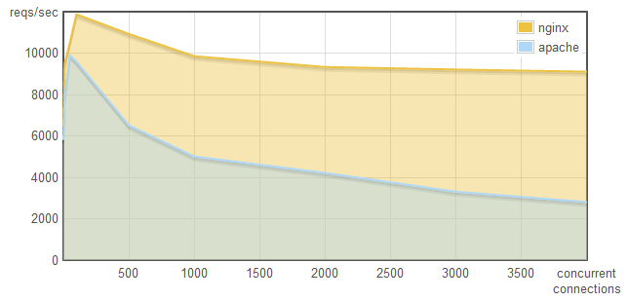
Apache vs NGINX
concurrency × reqs/sec

Slide 5
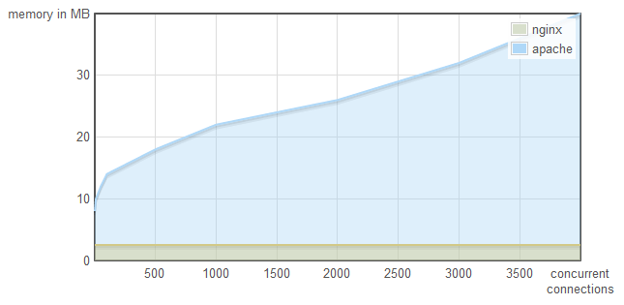
Apache vs NGINX
concurrency × memory

Slide 6
Apache vs NGINX
The difference?
Apache uses one thread per Connection.
NGINX doesn’t use threads. It uses an event loop.
For massive concurrency, cannot use an OS thread for each connection.

Slide 7
Design Goals
No function should direct perform I/O. To receive info from disk, network, or another process there must be a callback.
●
●

Slide 8

Code like this
either blocks the entire process or implies multiple execution stacks.

Slide 9

But a line of code like this
allows the program to return to the event loop immediately.
No machinery required.
This is how I/O should be done.

Slide 10
Design Goals
Low-level.
Stream everything; never force the buffering of data.
Have built-in support for the most important protocols:
●
●
●
TCP
DNS HTTP
●
●

Slide 11
Design Goals
Support many HTTP features.
Chunked requests and responses. Keep-alive.
Hang requests for comet applications.
●
●

Slide 12
Design Goals
●
The API should be both familiar to client-side JS programmers and old school UNIX hackers.
Be platform independent.
●

Slide 13
Benchmarks
nginx v0.7.65 node v0.1.91
tornado v0.2 (python 2.6.4) thin v1.2.7 (ruby 1.9.1-p376)
●
●
●
●
In Linux using a Intel Core 2 Due 2.53, 4 GB memory

Slide 14

The standard ‘hello world’ concurrency benchmark.
(Approximately 100 byte response for each.)

Slide 15
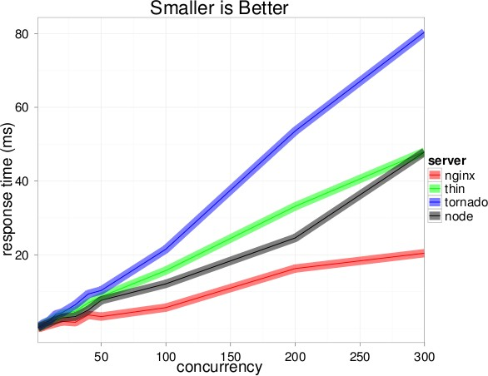

Slide 16
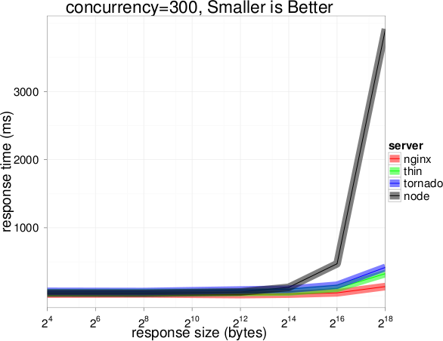

Slide 17
Wow. Node sucks at serving large files.
Well over 3 second responses for 256 kilobyte files at 300 concurrent connections.

Slide 18
What’s happening:
V8 has a generational garbage collector. Moves objects around randomly.
Node can’t get a pointer to raw string data to write to socket.

Slide 19
Using Node’s new Buffer object, the results change.

Slide 20
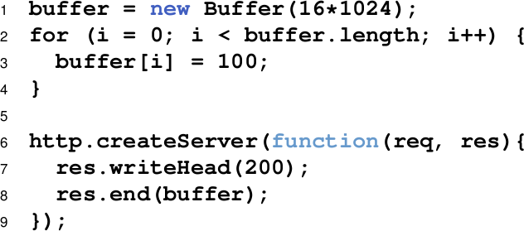

Slide 21
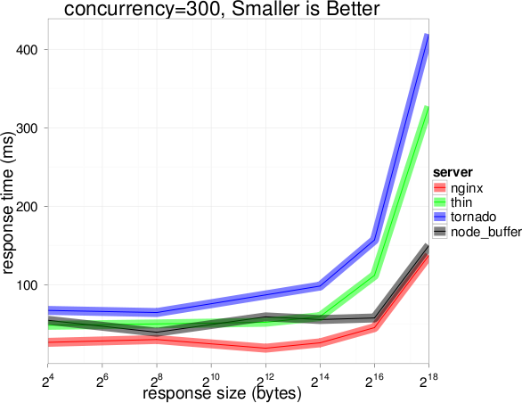

Slide 22
Installation
https://github.com/joyent/node/wiki/Installation

Slide 23
THANK YOU ☺

